Slide 1
A New Perspective on Multiple Internal Rates of Return
Group 9 Member:
DAI Zhiyu LIU Yingjun
SHI Qi WANG Xinyu
ZENG Jing ZHANG Hankun

Slide 2
Content
Introduction
General case & special case
Current consensus & our POV
Theorem & logic
R code & example
Database & description
Conclusion & limitation

Slide 3
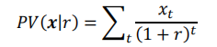
IRR (Internal Rates of Return)
Definition:
The internal rate of return (IRR) is a widely used tool for evaluating deterministic cash flow streams.
IRR(x) be the set of all interest rates which make PV(x|r)=0
Formula:

Slide 4
General case of using IRR
01
For conventional cash flows that are negative for the first few periods but positive thereafter, the internal rate of return exists and is unique.
02
Moreover, the internal rate of return is the largest interest rate at which the cash flow shows a discounted net profit.
03
If IRR(x)> r, available market rate of interest, then PV(x|r)>0, investment is worthwhile.
Conversely, if IRR(x)<r, it’s better off investing at the market rate r.

Slide 5
Difficulty and Limitation for Special case
It cannot be used to rank cash flows for mutually exclusive projects, except on an incremental basis. It does not extend well to situations involving uncertainty.
Besides, the most widely cited difficulty for IRR is the fact that a cash flow stream can have multiple conflicting internal rates, or no real-valued internal rate at all.

Slide 6
Current Consensus
Multiple internal rates constitute a severe drawback.
Incorrect, invalid, useless, meaningless, inaccurate, ambiguous and contradictory.
"...when multiple rates of return are found, there is no rational means for judging which of them is most appropriate for determining economic desirability".
When there are no real-valued internal rates of return, then the IRR approach must be abandoned altogether.

Slide 7
Our point of view
Useful, valid, meaningful, correct, explainable, and non-contradictory.
There’s a rational means for using multiple or even complex valued internal rates of return to determine economic viability.
It does not matter which rate is used to accept or reject the cash flow stream, as long as one identifies the underlying investment stream as a net investment or net borrowing.
Regardless of which rate is chosen, the cash-flow acceptance or rejection decision will be the same, and consistent with net present value.

Slide 8
Theorem
01
If investment stream 𝑐 = (𝑐0, … , 𝑐𝑇−1 ) yields cash flow stream 𝒙 = (𝑥0, 𝑥1, … , 𝑥𝑇 ) at constant per-period rate of return 𝑘, then for 𝑟 ≠ −1,
𝑃𝑉(𝑥 ∣ 𝑟) = (𝑘 − 𝑟)/(1 + 𝑟 )⋅ 𝑃𝑉(𝑐 ∣ 𝑟)
02
𝑘 is an internal rate of return for a cash flow stream 𝒙 if and only if there exists an investment stream 𝒄 which yields 𝒙 at constant per-period rate of return 𝑘.
Corollary: IRR=(1)=(2)
(1) the constant per-period rate of return at which some investment stream yields 𝒙.
(2) an interest rate which makes the present value equal to zero

Slide 9
Theorem
Real valued rate of return
03
Suppose internal rate of return k, cash flow stream 𝒙, and 𝒄 be
the investment stream yielding 𝒙 at constant per-period rate of return 𝑘.
a) net investment: If 𝑃𝑉(𝑐 ∣ 𝑟) > 0, then 𝑃𝑉(𝒙 ∣ 𝑟) ≥ 0 if and only if 𝑘 ≥ 𝑟.
b) net borrowing: If 𝑃𝑉(𝑐 ∣ 𝑟) < 0 , then 𝑃𝑉(𝒙 ∣ 𝑟) ≥ 0 if and only if 𝑘 ≤ 𝑟.
c) If 𝑃𝑉(𝑐 ∣ 𝑟) = 0 then 𝑃𝑉(𝑥 ∣ 𝑟) = 0.
Intuition: the investor should like returns on exceeding the market rate; but repayment rate for the loan is less than the market rate .
04

Slide 10
Theorem
Complex valued rate of return
05
Suppose 𝑘 is a (possibly complex-valued) internal rate of return,
𝒄 be the corresponding (possibly complex-valued) investment stream yielding 𝒙 at return 𝑘.
a) net investment:(𝑃𝑉(Re(𝑐) ∣ 𝑟) > 0 ) then 𝑃𝑉(𝑥 ∣ 𝑟) ≥ 0 if and only
if Re(𝑘) ≥ 𝑟.
b) net borrowing:(𝑃𝑉(Re(𝑐) ∣ 𝑟) < 0) then 𝑃𝑉(𝒙 ∣ 𝑟) ≥ 0 if and only
if Re(𝑘) ≤ 𝑟.

Slide 11
Tools in R (pseudocode)
Decision = function(cf,r)
npv(cf,r)
irr(cf)
# Calculate NPV of investment stream:
c[,1] = cf[1]
for i = 1: length(irr)
for j = 2 : length(cf) - 1
C[i,j] = - (1 + irr[i] ) * c[i,j-1] - cf[j]
npvc = npv(c,r)
# Making decision:
If npvc*(Re(irr) - r) >= 0
Accept
else
Refuse
Our input here are cash flow and marketing rate r
The calculation of investment flow here is based on theorem 2
Our output are the NPV of the cash flow, IRR, NPVC and our decisions

Slide 12
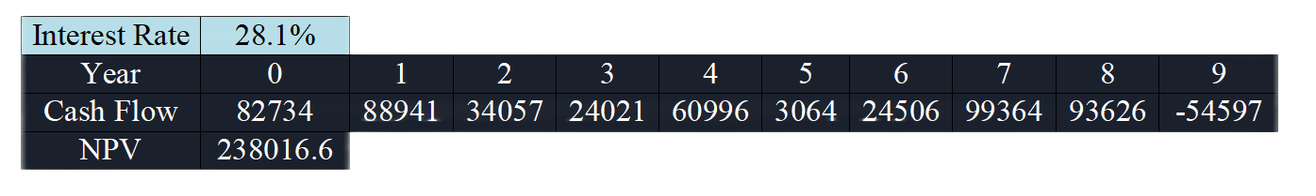
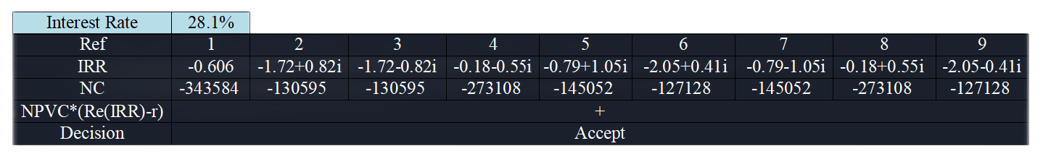
Tools in R (example)
The dataset:
The results:
Here we see that, the decision based on IRR is equal to the decision based on NPV: Accept

Slide 13
Interpreting multiple internal rates
How can a cash flow stream meaningfully have several different rates of return?
All that should matter about an internal rate of return is whether it exceeds the market rate 𝑟.
The magnitude of the internal rate by itself carries no further information.
Internal rates should not in general be compared between different investment streams.

Slide 14
Interpreting multiple internal rates
One internal rate has a greater magnitude than another for the same cash flow only indicates that the corresponding net investment has smaller magnitude. There are no other economic implications.
Different IRR yields the same present value of net income. For internal rates within a project, there is only one cash flow stream to examine. The conclusion is that all internal rate/ investment stream combinations are equivalent. Therefore, we do not need to examine all IRRs and compare.

Slide 15
Summary
Solve for an internal rate of return, compute the corresponding investment stream, check the sign of its net present value to determine whether it is a net investment or net borrowing, then treat the internal rate of return accordingly.

Slide 16
A cash flow stream can always be interpreted as the yield of any of several investment streams at several different internal rates.
Each IRR will lead to conclusions consistent with the net present value in the same cash flow.

Slide 17
Conclusion
The IRR method can still be used to make business decisions in multiple or nonexistent internal rates of return situations with little treatment.

Slide 18
Thank you!

